Slide 1
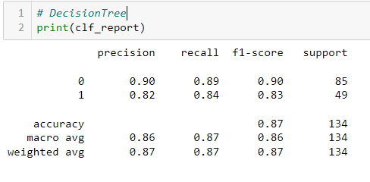
1)What is the Problem Statement?
purchased output is classification , so problem statement is classification
2)What is the over all performance?
accuracy is the over all performance , here 87%
3)What is the correct performance of the purchase?
correct performance mean recall , purchase correct performance is 84%
4)What is the precision performance of the Not purchase?
correct prediction + wrong prediction both include is precision metrics
here precision performance for not purchase is 90%

Slide 2
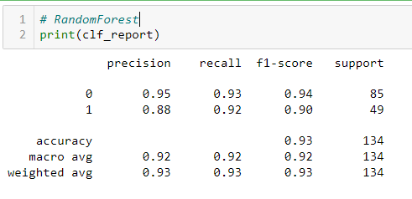
1)What is the Problem Statement?
purchased output is classification , so problem statement is classification
2)What is the over all performance?
accuracy is the over all performance , here 93%
3)What is the correct performance of the Not purchase?
correct performance mean recall , not purchase correct performance is 93%
4)What is the precision performance of the purchase?
correct prediction + wrong prediction both include is precision metrics
here precision performance for purchase is 88%

